Slide 1
CPE 10 FUNDAMENTALS OF MIXED SIGNALS AND SENSORS
BSCPE III GE – MF 9:00 – 10:30 BSCPE III GF – TTH 9:00 – 10:30
ENGR. RALPH MONSOUR Z. DELIMA, ECT
SEPTEMBER 2024

Slide 2
COURSE DESCRIPTION
This course covers operational amplifiers, signal converters, power switching devices and construction and operation of sensors and transducers for converting physical parameters into electrical signals and vice versa. The course focuses on

Slide 3
COURSE DESCRIPTION
the application of these devices in developing signal conversion circuits that allows measurement, processing and control of physical parameters by digital processing systems such as finite state machine or a digital computer. Topics on actuators are also included.

Slide 4
COURSE OUTLINE
1. Differential Amplifiers
2. Operational Amplifiers
3. Linear and Non-Linear Applications of Op-Amp
4. Analog to Digital Conversion
5. Digital to Analog Conversion

Slide 5
COURSE OUTLINE
6. Other Mixed Signals
7. Basic Measurement Theory
8. Sensors and Transducers
9. Other Types of Sensors and Transducers
10. Basic Control Devices

Slide 6
Course Requirements
Exams 40%
Performance 30%
Quizzes 15%
Recitation 15%
Total 100%

Slide 7
GRADING SYSTEM
Passing weighted average of 60%.

Slide 8
Textbooks and References
Electronic Devices and Circuit Theory, Boylestad and Nashelsky, 12th ed, 2013
Electronic Devices, Floyd, 9th ed, 2012
Basic Electronics, Gupta, 2017
Grob’s Basic Electronics, Shultz, 12th ed, 2011

Slide 9
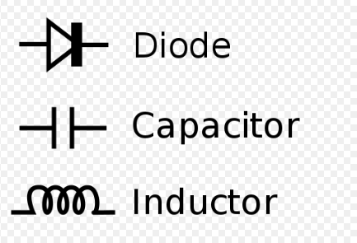
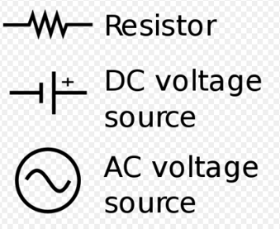
Basic Electronics Symbols

Slide 10
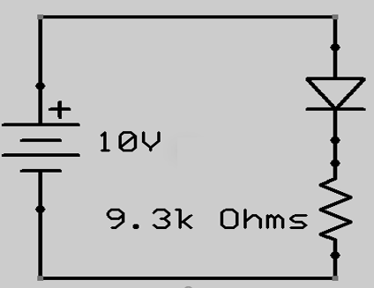
Basic Electronic Circuit

Slide 11
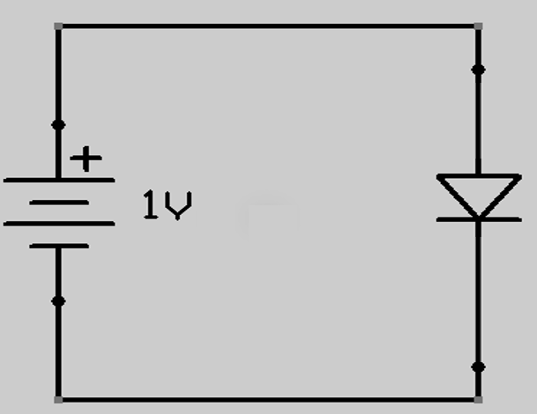
Basic Electronic Circuit

Slide 12
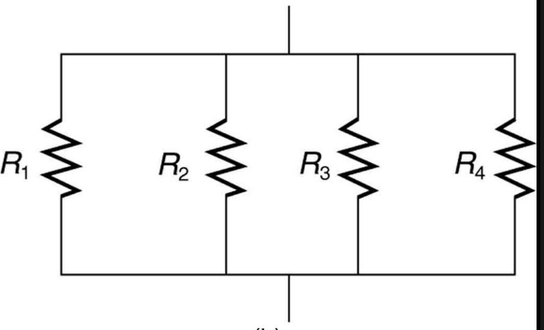
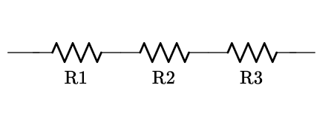
Series and Parallel Resistors

Slide 13
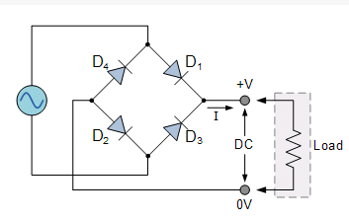
Full Wave Bridge Rectifier Ckt

Slide 14
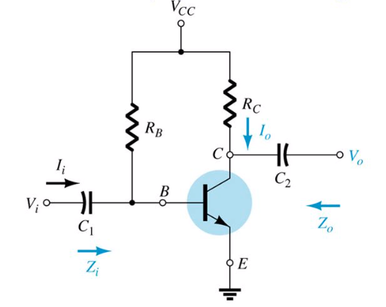
Common Emitter Fixed Bias Ckt

Slide 15
INTRODUCTION
An operational amplifier or op-amp, is a very high gain differential amplifier with high input impedance and low output impedance. It is used to provide voltage amplitude changes (amplitude and polarity), oscillators, filter circuits and many type of instrumentation circuits. (Boylestad and Nashelsky)

Slide 16
INTRODUCTION
An op-amp is basically a multistage, very high gain (typically 200 000), direct coupled, negative feedback amplifier that provides a stabilized voltage gain. (Gupta)
An op-amp contains a number of differential amplifier stages to achieve a very high voltage gain.

Slide 17
OPERATIONAL AMPLIFIERS Characteristics
Very high gain differential amplifier
High input impedance (M-Ω)
Low output impedance (< 100 Ω)

Slide 18
OP AMPS APPLICATIONS
Voltage amplitude and polarity changes
Oscillators
Filter Circuits
Instrumentation Circuits

Slide 19
Inputs:
Single ended
Double ended
Outputs:
Single ended
Double ended

Slide 20
Modes of Operation:
Common Mode
Common Mode Rejection

Slide 21
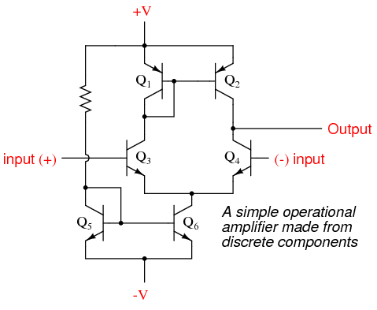
Op Amp equivalent circuit diagram

Slide 22
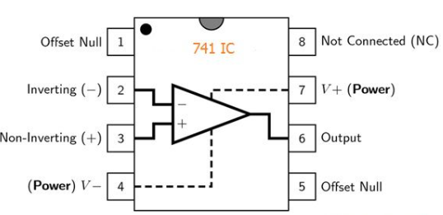
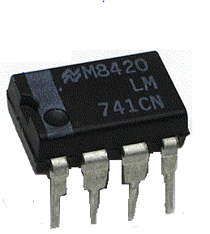

IC 741 Op Amp
8 pin DIP
pin configuration

Slide 23
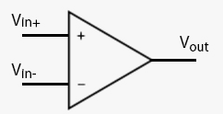
BASIC OP AMP SYMBOL

Slide 24
BASIC OP AMP
A basic op-amp with two inputs and one output using a differential amplifier input stage. Each input results in either the same or an opposite polarity output, depending on whether the signal is applied to the plus (+) or the minus (-) input.

Slide 25
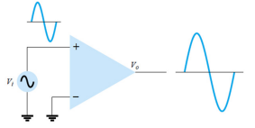
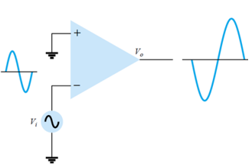
Single Ended Input
Single-ended input operation results when the input signal is connected to one input and the other input connected to ground.

Slide 26
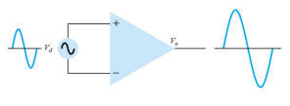
Double Ended (Differential) Input
A single input can be use, applied between the two terminals, neither input is at ground. With the resulting amplified output in phase with the applied inputs.

Slide 27
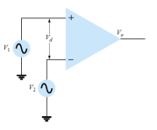
Double Ended (Differential) Input
Two separate signals are applied to the inputs, the difference signal being V1 - V2.

Slide 28
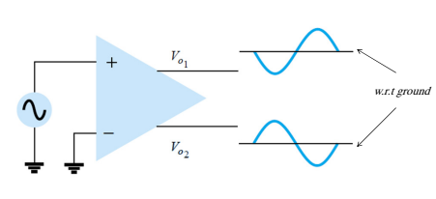
Double Ended Output
Single ended input with double ended output. An input applied to either input will result in outputs from both output terminals, these outputs being always opposite in polarity.

Slide 29
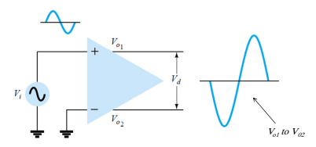

Double Ended Output
The figure shows a differential input, differential output operation. The input is applied between the two input terminals and the output taken from between the two output terminals, this is fully differential operation

Slide 30
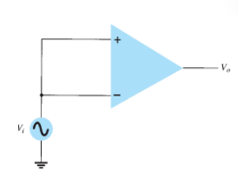
Common mode operation
When the same input signals are applied to both inputs, common mode operation results. Ideally, the two inputs are equally amplified and since they result in opposite
polarity signals at the output, these signals cancel, resulting in 0 V output. Practically, a small output signal will result.

Slide 31
Noise (any unwanted input signal) is generally common to both inputs, the differential connection tends to provide attenuation of this unwanted input while providing an amplified output of the difference signal applied to the inputs.
This operating feature is referred to as common - mode rejection.

Slide 32
DIFFERENTIAL AND COMMON MODE OPERATION
ability to greatly amplify signals that are opposite at the two inputs, while only slightly amplifying signals that are common to both inputs

Slide 33
Differential Inputs When separate inputs are applied to the op-amp, the resulting difference signal is the difference between the two inputs.
Vd = Vi1 - Vi2

Slide 34
Common Inputs When both input signals are the same, a common signal element due to the two inputs can be defined as the average of the sum of the two signals.
Vc = ½ (Vi1 + Vi2)

Slide 35
Output Voltage Since any signals applied to an op-amp in general have both in-phase and out-of-phase components, the resulting output can be expressed as
Vo = AdVd + AcVc

Slide 36
Output Voltage where
Vd = difference voltage
Vc = common voltage Ad = differential gain of the amplifier Ac = common-mode gain of the amplifier

Slide 37
Opposite Polarity Inputs If opposite polarity inputs applied to an op-amp are ideally opposite signals, Vi1 = -Vi2 = Vs, the resulting difference voltage is
Vd = Vi1 -Vi2 = Vs - (-Vs) = 2Vs

Slide 38
Opposite Polarity Inputs while the resulting common voltage is
Vc = ½(Vi1 + Vi2) = ½ [Vs +(-Vs)] = 0
so that the resulting output voltage is
Vo = AdVd + AcVc = Ad(2Vs) + 0 = 2AdVs

Slide 39
Opposite Polarity Inputs When the inputs are an ideal opposite signal (no common element), the output is the differential gain times twice the input signal applied to one of the inputs.

Slide 40
Same Polarity Inputs If the same polarity inputs are applied to an op-amp, Vi1 = Vi2 = Vs, the resulting difference voltage is
Vd = Vi1 -Vi2 = Vs - Vs = 0

Slide 41
Same Polarity Inputs while the resulting common voltage is
Vc = ½(Vi1 + Vi2) = ½(Vs + Vs) = Vs
so that the resulting output voltage is
Vo = AdVd + AcVc
= Ad(0) + AcVs = AcVs

Slide 42
Same Polarity Inputs When the inputs are ideal in-phase signals (no difference signal), the output is the common-mode gain times the input signal, Vs, which shows that only common-mode operation occurs.

Slide 43
Common-Mode Rejection To measure Ad set Vi1 = -Vi2 = Vs = 0.5 V
Vd = (Vi1 – Vi2) = [0.5V – (-0.5V)] = 1V &
Vc = ½(Vi1 + Vi2) = ½[0.5V + (-0.5V)] = 0V
By substitution, the output voltage is
Vo = AdVd + AcVc = Ad(1V) + Ac(0) = Ad

Slide 44
Common-Mode Rejection setting the input voltage to Vi1 = -Vi2 = Vs = 0.5 V results in an output voltage numerically equal to the value of Ad.

Slide 45
Common-Mode Rejection To measure Ac set Vi1 = Vi2 = Vs = 1 V
Vd = (Vi1 – Vi2) = (1V – 1V) = 0V &
Vc = ½(Vi1 + Vi2) = ½(1V + 1V) = 1V
By substitution, the output voltage is
Vo = AdVd + AcVc = Ad(0V) + Ac(1V) = Ac

Slide 46
Common-Mode Rejection
setting the input voltage to Vi1 = Vi2 = Vs = 1V results in an output voltage numerically equal to the value of Ac.

Slide 47
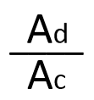
Common-Mode Rejection Ratio Having obtained Ad and Ac, we can now calculate a value for the common-mode rejection ratio (CMRR), which is
CMRR =

Slide 48
Common-Mode Rejection Ratio The value of CMRR can also be expressed in logarithmic terms as
CMRR (log) = 20 log10

Slide 49
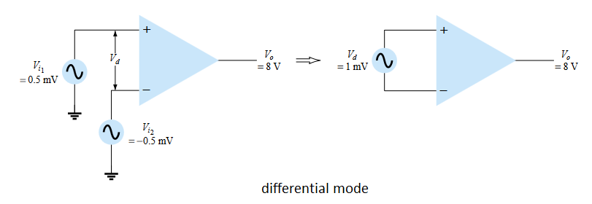
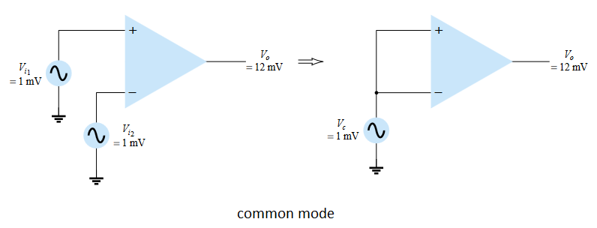
Calculate the CMRR for the circuit measurements

Slide 50
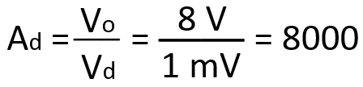
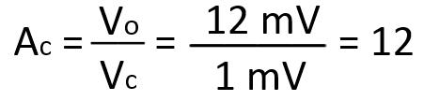
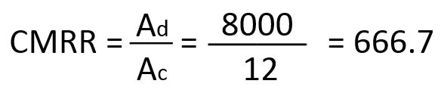


Calculate the CMRR for the circuit measurements
for Ad:
for Ac:

